Slide 1


Lecture 4: Data Science – Regression & Classification
COMP704: Machine Learning
MSc Artificial Intelligence for Games

Slide 2
Today’s session:
Wrap up from the regression workshop
Classification Learning Algorithm
Workshop

Slide 3
Wrap up from the regression workshop

Slide 4
Wrap up from the regression workshop
Last week, we looked at a couple of datasets (sine() & Boston house prices)
What did we learn?
‘performance’ is about understanding level of errors
Under & over-fitting
What is acceptable
Whether errors are universal or localised
Fixing issues
More data
More specific data
Hyper parameters -> GAs

Slide 5
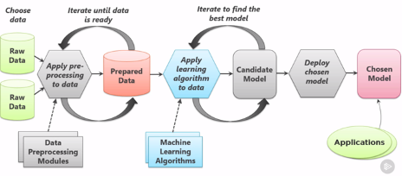
Wrap up from the regression workshop
Last week, we looked at a couple of datasets (sine() & Boston house prices)
What did we learn?
Iteration is key, but what to iterate

Slide 6
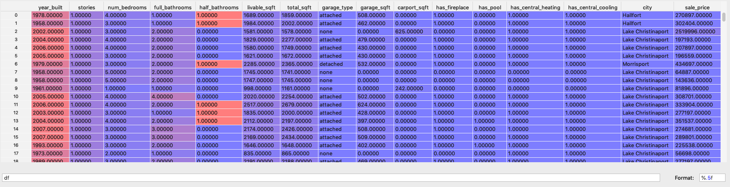
Wrap up from the regression workshop
Data complexity
On the surface, the house price data looks quite benign
There’s a lot of it ;)
Can view this data in PyCharm (select View as … from variable window)

Slide 7

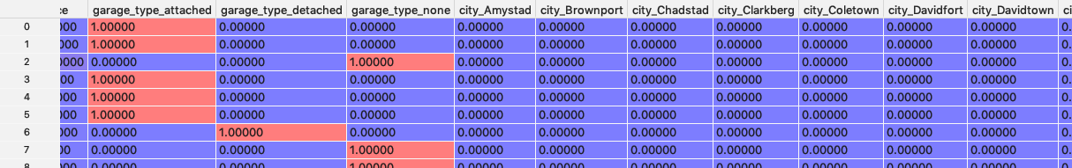
Wrap up from the regression workshop
Data complexity
On the surface, the house price data looks quite benign
This is a killer statement
Regression (& most other learning algorithms can’t work with strings)
get_dummies will covert a column of string entries to a set of Boolean columns
& add *lots* of columns

Slide 8
Wrap up from the regression workshop
Data complexity
Regression is working on multiple dimensions of data (60+ in house prices)
Hence, the scope to go back to the data model to ‘fix’ issues
Can we reduce complexity?

Slide 9
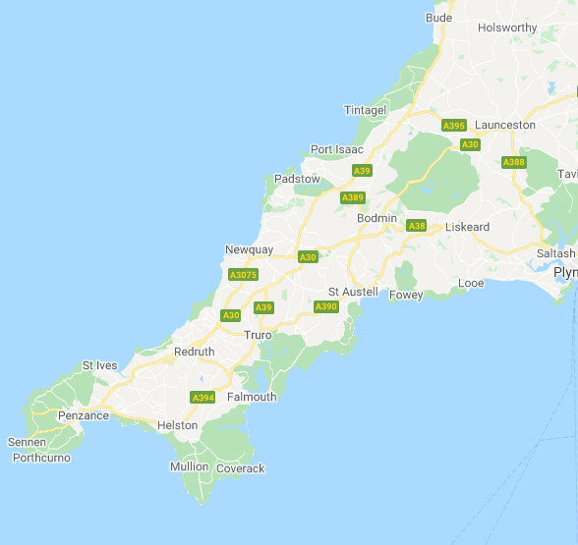
Wrap up from the regression workshop
Data complexity
Can we reduce complexity?
Does it make sense to have house prices from different cities in one dataset?
Perhaps split them into different models
We know that local house prices aren’t uniform

Slide 10
Wrap up from the regression workshop
Data complexity
Can we reduce complexity?
Does it make sense to track the exact price of houses?
What about looking at price ranges?
$100,000-$150,000
$150,001-$200,000
etc
Putting data into input ‘buckets’ reduces complexity and should lead to better results
Likewise for built period, sq.footage and so on

Slide 11
Wrap up from the regression workshop
Data complexity
Can we reduce complexity?
Does it make sense to track the exact price of houses?
What about looking at price ranges?
$100,000-$150,000
$150,001-$200,000
etc
Putting data into input ‘buckets’ reduces complexity and should lead to better results
Though making the output a bucket will move us away from true regression (lack of continuous output)
Maybe helpful given DS domain considerations

Slide 12
Wrap up from the regression workshop
Data complexity
We can see the core activity of machine learning is data processing (or pre-processing)
Relies on our understanding of the problem domain (data science)
What data is key to work with
How can data be grouped
What granularity is required
This is an iterative process as you can largely guarantee that you wont be right first time (or second time …)

Slide 13
Classification Learning Algorithm

Slide 14
Classification Learning Algorithm
Classification is used when:
We have supervised learning (desired outputs)
Discrete (non-continuous) outputs

Slide 15
Classification Learning Algorithm
Multilayer perceptron classifiers (MLPClassifier)
Perceptrons are a class of neural network
Focus of early non-symbolic AI research
Geared around loose approximation of human neurons
Multiple inputs that can trigger an output
From a desire to make AI that is good at solving the kinds of problems that humans are good at solving

Slide 16
Classification Learning Algorithm
Multilayer perceptron classifiers (MLPClassifier)
Perceptrons are a class of neural network
Focus of early non-symbolic AI research
Rosenblatt demonstrated that a single layer perceptron could learn logic gates
The ‘electronic brain’
Mintzky demonstrated that they couldn’t be taught XOR
The end of the ‘electronic brain’
However, adding hidden layers to the architecture made them far more useful

Slide 17
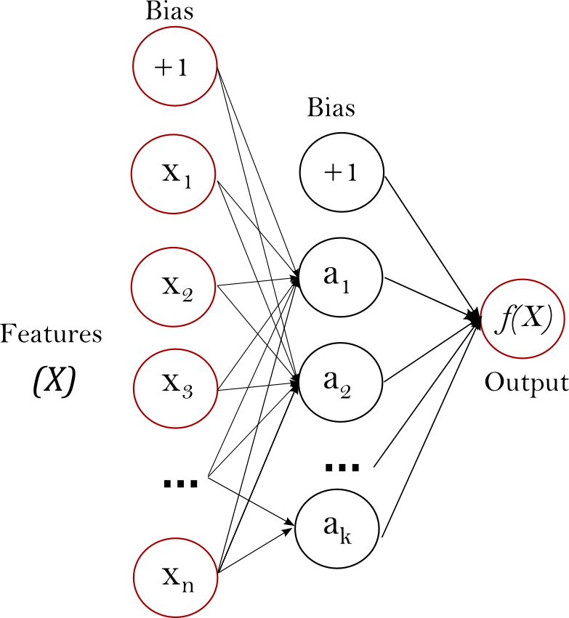
Classification Learning Algorithm
Multilayer perceptron classifiers (MLPClassifier)
Perceptrons are a class of neural network
However, adding hidden layers to the architecture made them far more useful

Slide 18
Classification Learning Algorithm
Multilayer perceptron classifiers (MLPClassifier)
Process
Input (X) are encoded on the left and passed across to the output (Y)
Each node in the next layer will summate its inputs and apply a bias term to determine its output value.

Slide 19
Classification Learning Algorithm
Multilayer perceptron classifiers (MLPClassifier)
Learning
Output is compared with desired output and differences (error) is propagated back through the network to adjust bias values
Hence ‘back propagation network’ & ‘feedforward network’
This is all dealt with by sklearn ☺

Slide 20
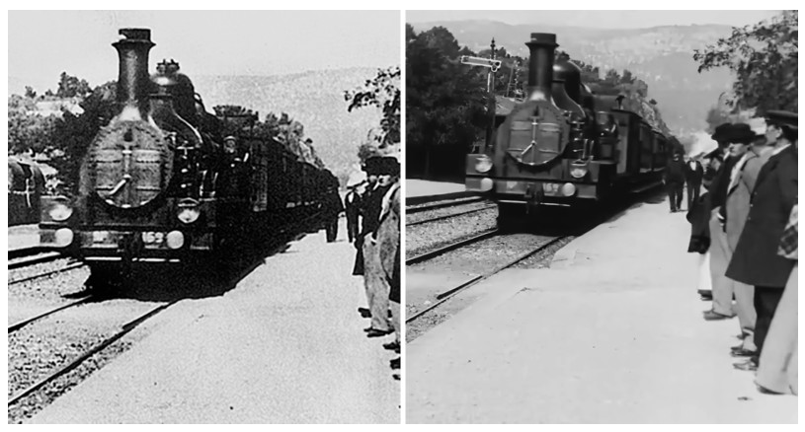
Classification Learning Algorithm
Other neural network classifiers
Recurrent network
As per Mariflow, with ‘memory’
Connections are not strictly feed-forward and can form cycles
Generative adversarial network
A system of 2 neural networks competing with game theory
https://petapixel.com/2020/02/05/youtuber-used-ai-to-upscale-a-classic-1896-short-film-to-4k-and-60fps

Slide 21
Classification Learning Algorithm
Sklearn limitations
Neural network training benefits greatly from gpu accelerations
All those node calculations lend themselves to vector units
Currently, sklearn doesn’t support this
But other learning frameworks do
Sklearn provides sklearn-style wrappers for them
Or use other frameworks

Slide 22
Classification Learning Algorithm
Let’s do some learning
1. Data acquisition ( & pre-processing)
Sklearn supports two types of BPN / MLP
MLPRegressor
Continuous data output
Just like the regressor last week
MLPClassifier
Discontinuous data output
Just like Mariflow
We’ll need to bucket up the outputs

Slide 23
Classification Learning Algorithm
Let’s do some learning
1. Data acquisition ( & pre-processing)
MLPRegressor
Supplied house price data didn’t work very well
Lots of inputs
Although there’s c44,000 data items, there’s 50-odd cites
c1,000 training items per city
Not really any good for training by city
Too big to quickly train either (44,000 entries x 60 inputs)

Slide 24
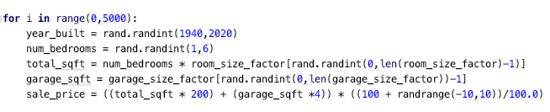
Classification Learning Algorithm
Let’s do some learning
1. Data acquisition ( & pre-processing)
MLPRegressor
To better test, I’ve built a house model
Pros | Cons
Massively scalable | Clear linear model
Clear linear model
A way to learn how to use pandas

Slide 25
Classification Learning Algorithm
Let’s do some learning
1. Data acquisition ( & pre-processing)
MLPRegressor
The house model allow me to get clear ideas on the relationships between
Data population size
Data disparity
Iterations of training
Over / under-fit issues

Slide 26
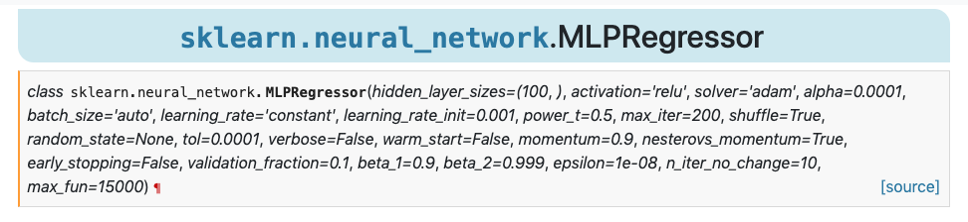
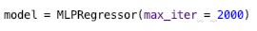
Classification Learning Algorithm
Let’s do some learning
2.Configure the training algorithm
Where mulit-layer perceptrons get interesting is that you can define your own hidden layer(s) configuration
https://scikit-learn.org/stable/modules/generated/sklearn.neural_network.MLPRegressor.html

Slide 27
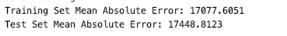
Classification Learning Algorithm
Let’s do some learning
3.Train
4.Evaluate with test data
5.Evaluate performance
6.Iterate or ship?
Just like regression learning
Results:
Not bad, but could do with being smaller (probably)

Slide 28

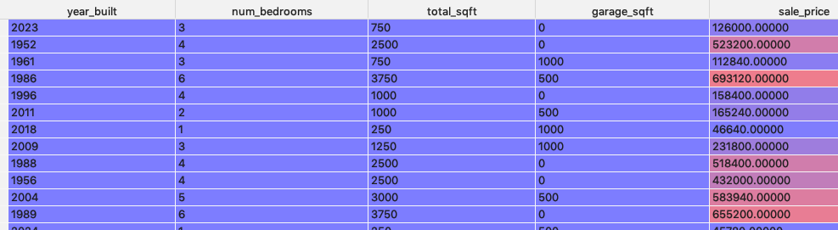
Classification Learning Algorithm
Let’s do some learning (7,500 population, 50%)

Slide 29
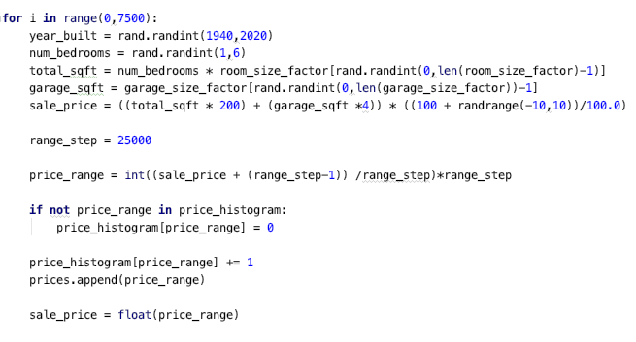
Classification Learning Algorithm
Let’s do some learning
1. Data acquisition ( & pre-processing)
MLPClassifier
First rule of classifier-club is that you have to group outputs
Will fail (crash) if you don’t do this

Slide 30
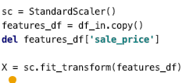
Classification Learning Algorithm
Let’s do some learning
1. Data acquisition ( & pre-processing)
MLPClassifier
Also recommend to use scaling on input data to make it ‘process better’
Remember to pickle scale data for app

Slide 31
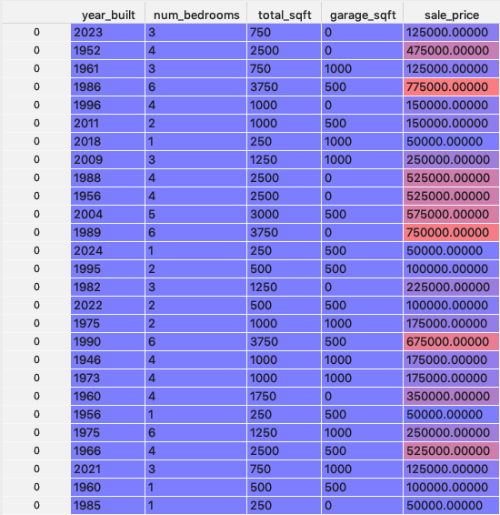
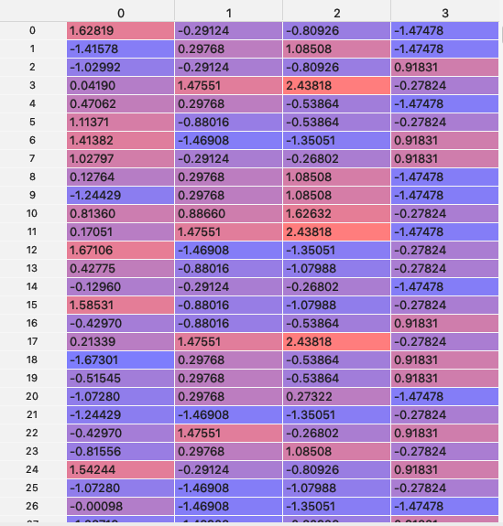
Classification Learning Algorithm
Let’s do some learning
1. Data acquisition ( & pre-processing)

Slide 32
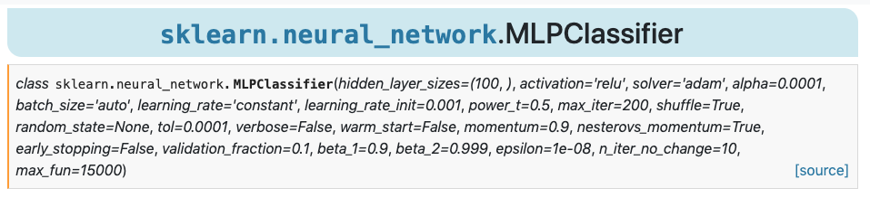

Classification Learning Algorithm
Let’s do some learning
2.Configure the training algorithm
Where the MLPClassifier gets interesting is that you can define your own hidden layer(s) configuration
https://scikit-learn.org/stable/modules/generated/sklearn.neural_network.MLPClassifier.html

Slide 33
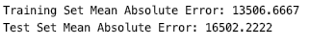
Classification Learning Algorithm
Let’s do some learning
3.Train
4.Evaluate with test data
5.Evaluate performance
6.Iterate or ship?
Just like regression learning
Results:
Again, not bad, but could do with being smaller (probably)

Slide 34

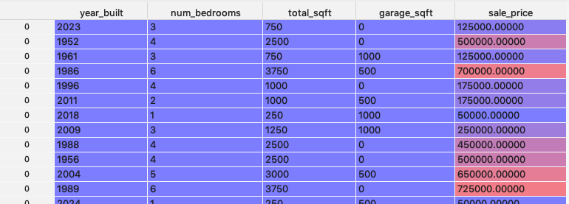
Classification Learning Algorithm
Let’s do some learning (7,500 pop & 75% train)

Slide 35
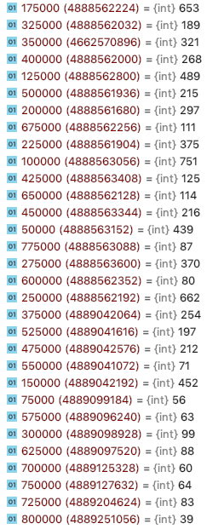
Classification Learning Algorithm
Let’s do some learning (7,500 pop & 75% train)
Storing the house prices as a histogram gives us some insight into data occurrence

Slide 36
Classification Learning Algorithm
Let’s do some learning (7,500 pop & 75% train)
Storing the house prices as a histogram gives us some insight into data occurrence
Ideally, all ranges should be equal
Equal chance of being in training data
125000 -> 489 occurrences
775000 -> 700000, only 87 occurrences
Flipping to a higher train/test ratio
Likely to result in over-fitting
Need more data in the hard to reach buckets

Slide 37
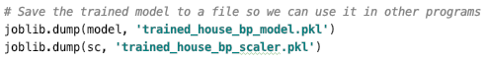
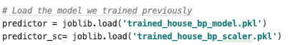
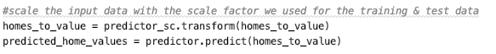
Classification Learning Algorithm
Let’s do some learning
7.Ship it
Just like regression, but with the scaler

Slide 38
Classification Learning Algorithm
Conclusions
Takes some work to make work
Data size!
MLP framework is far more likely to throw issues at you in code
Results often seem bonkers
Need to think about how to bucket input & output data for best use
Need to analyse data to determine training / learning issues

Slide 39
Do you have any questions for me?

Slide 40
Workshop

Slide 41
Workshop
This week, I want to have a look at:
Experiment with synthetic data
Experiment with original house price data
Covert output data type to multi-nodes

